Slide 1
Time series analysis

Slide 2
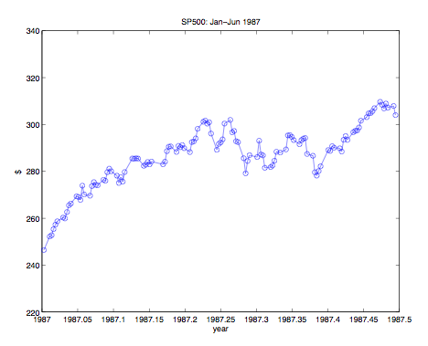
Example

Slide 3
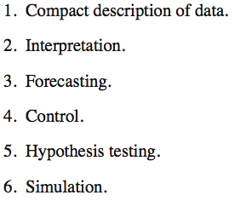
Objectives of time series analysis

Slide 4
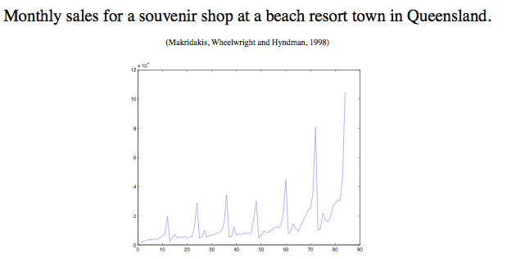
Classical decomposition: An example

Slide 5
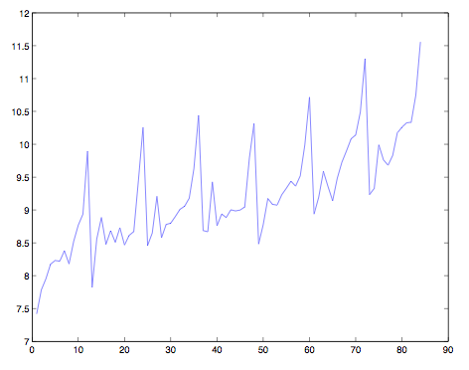
Transformed data

Slide 6
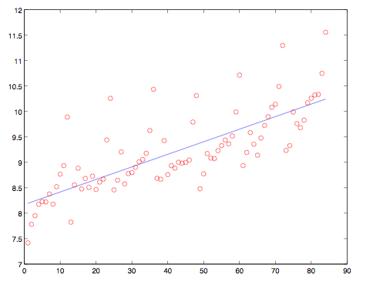
Trend

Slide 7
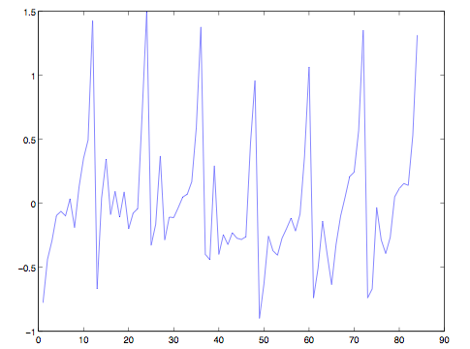
Residuals

Slide 8
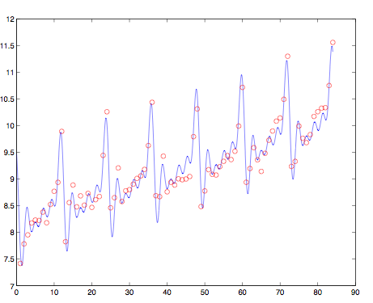
Trend and seasonal variation

Slide 9
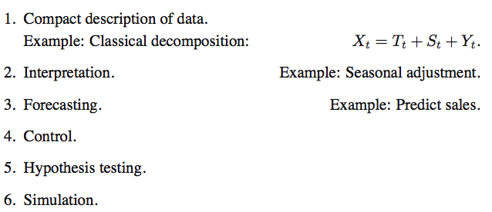
Objectives of time series analysis

Slide 10
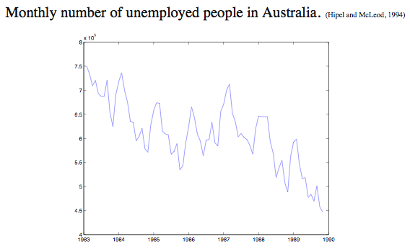
Unemployment data

Slide 11
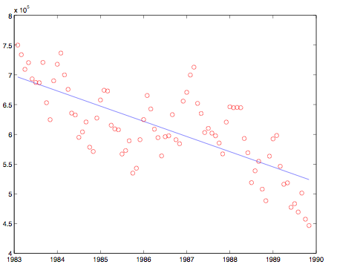
Trend

Slide 12
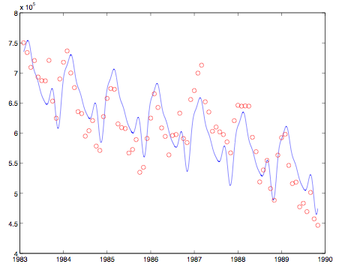
Trend plus seasonal variation

Slide 13
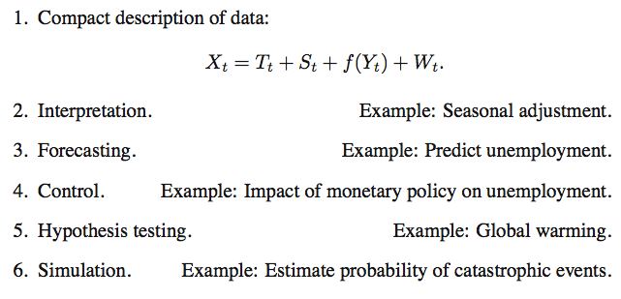
Objectives of time series analysis

Slide 14
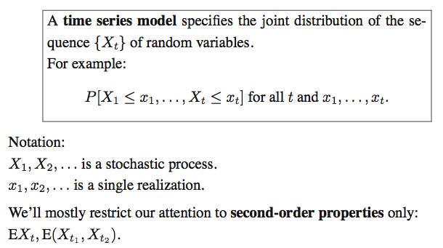
Time series models

Slide 15
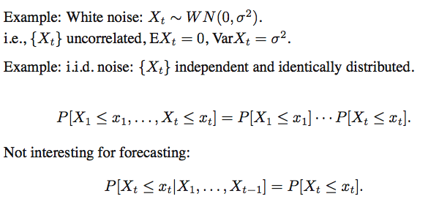
Time series models

Slide 16
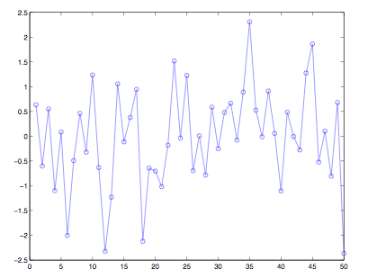
Gaussian white noise

Slide 17
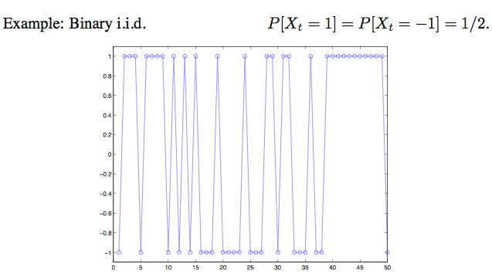
Time series models

Slide 18
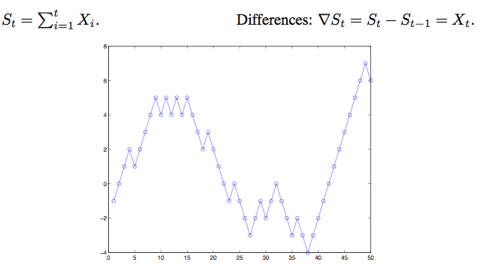
Random walk

Slide 19
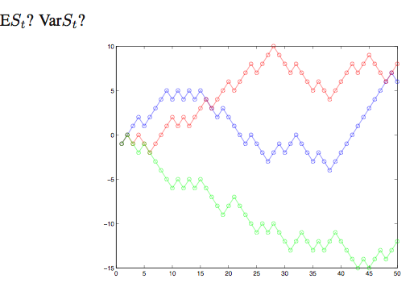
Random walk

Slide 20
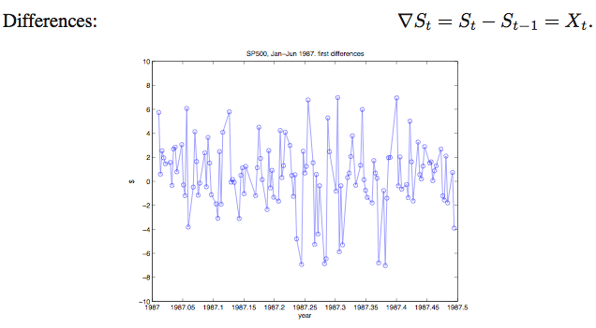
Random walk

Slide 21
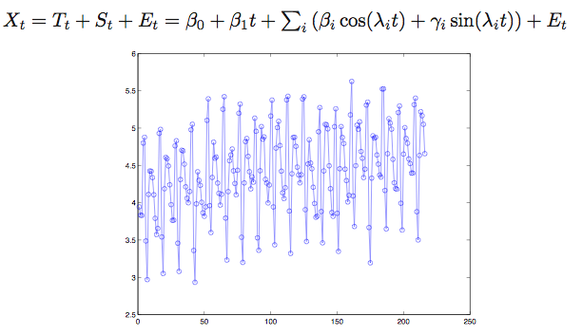
Trend and seasonal models

Slide 22
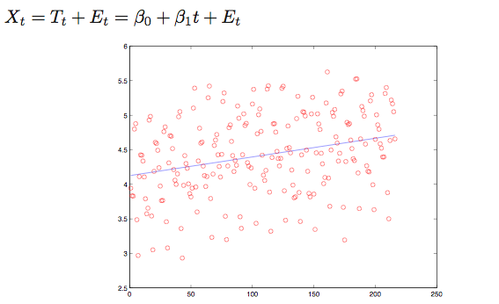
Trend and seasonal models

Slide 23
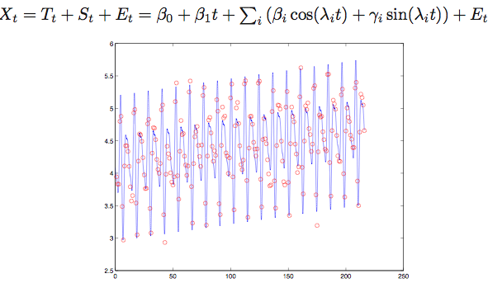
Trend and seasonal models

Slide 24
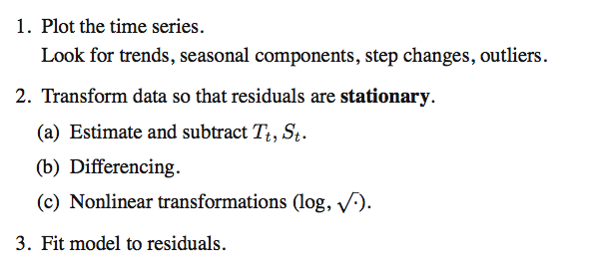
Time series modeling

Slide 25
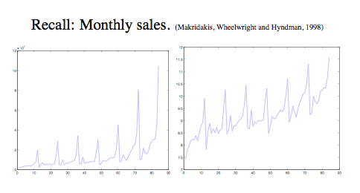
Nonlinear transformation

Slide 26
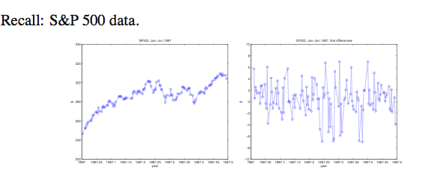
Differencing

Slide 27
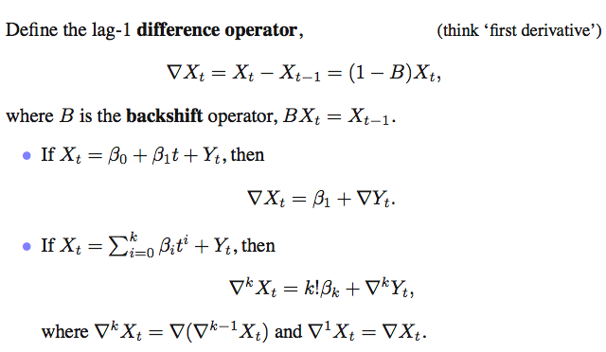
Differencing and trend

Slide 28
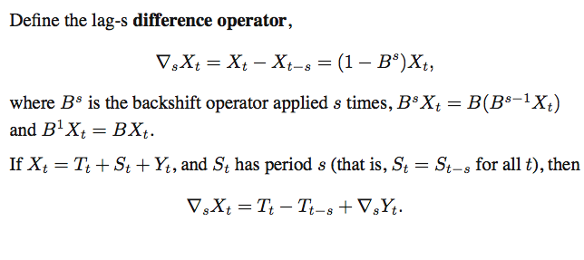
Differencing and seasonal variation

Slide 29
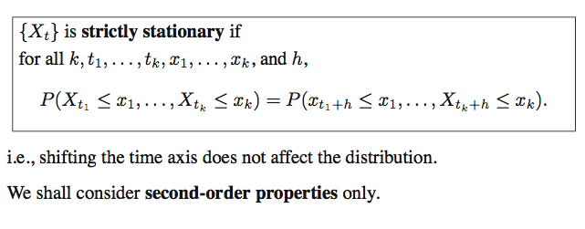
Stationarity

Slide 30
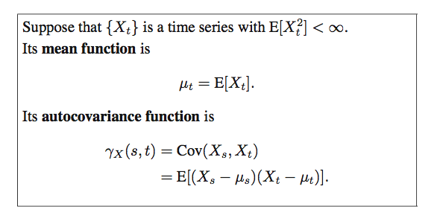
Mean and Autocovariance

Slide 31
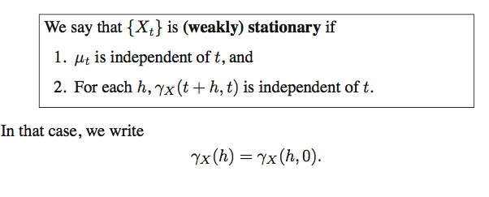
Weak stationarity

Slide 32
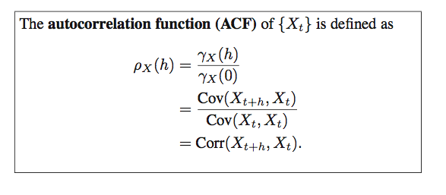
Stationarity

Slide 33
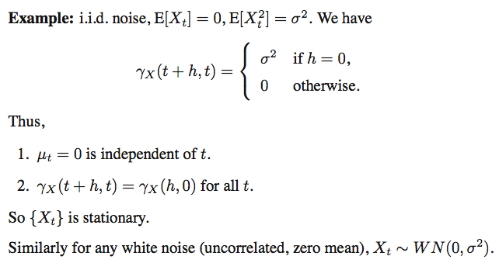
Stationarity

Slide 34
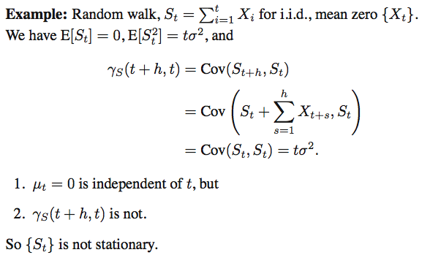
Stationarity

Slide 35
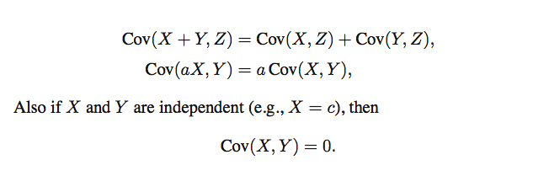
Covariances

Slide 36
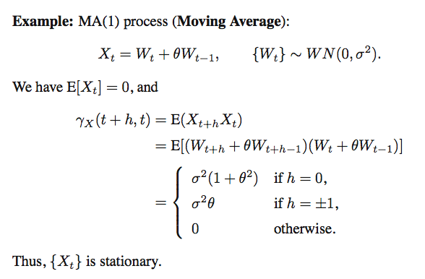
Stationarity

Slide 37
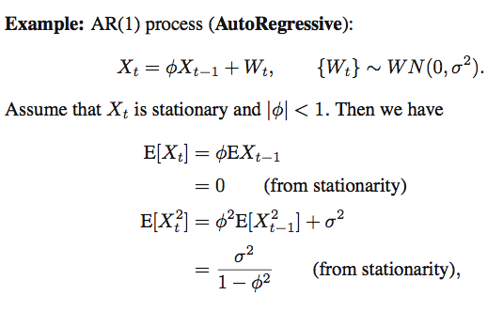
Stationarity

Slide 38
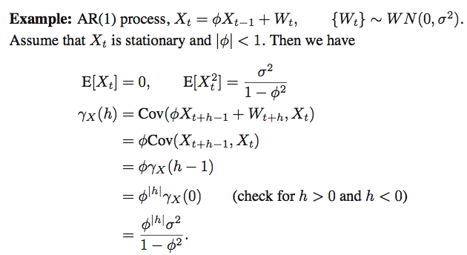
Stationarity

Slide 39
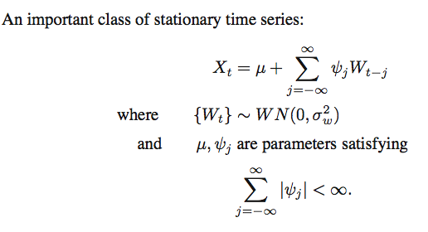
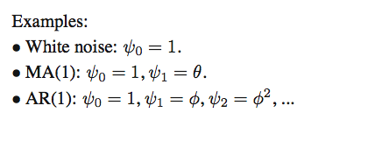
Linear process

Slide 40
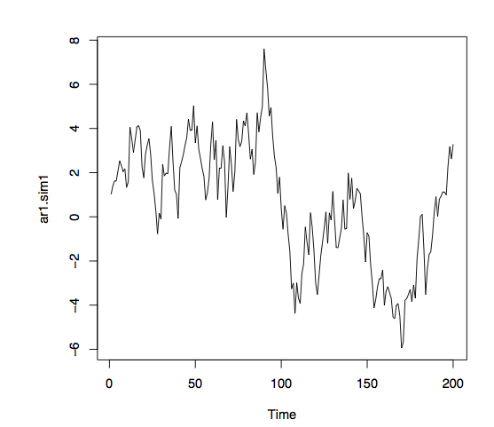
AR(1) :0.95

Slide 41
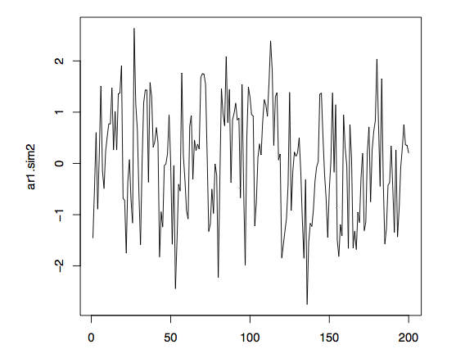
AR(1) :0.5

Slide 42
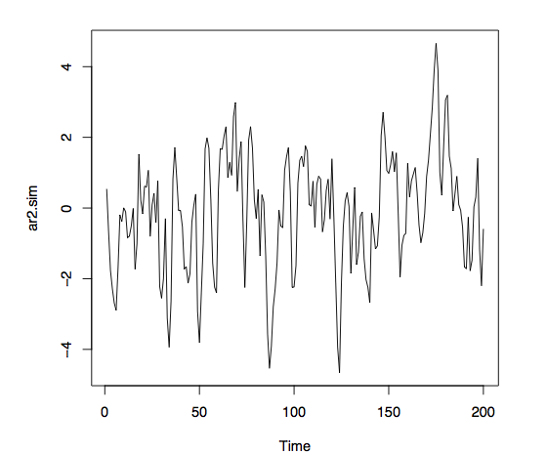
AR(2): 0.9, 0.2

Slide 43
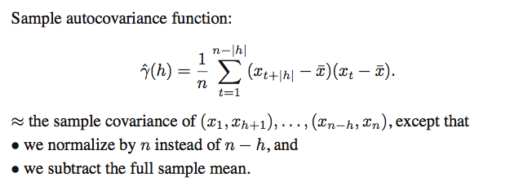
Sample ACF

Slide 44
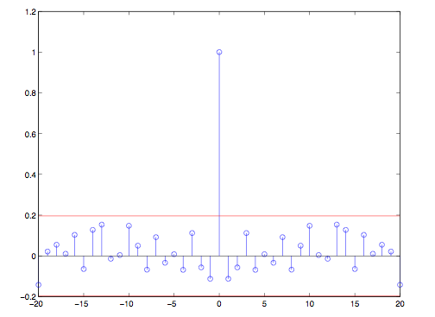
Sample ACF for Gaussian noise

Slide 45
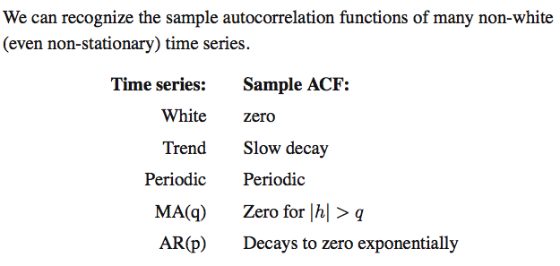
Summary for sample ACF

Slide 46
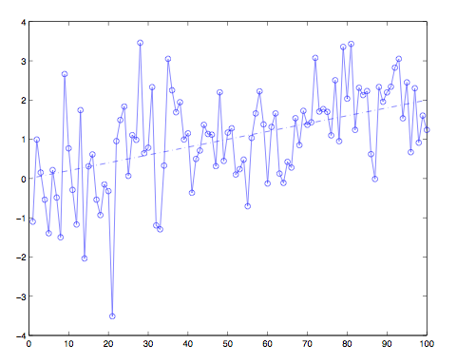
Trend

Slide 47
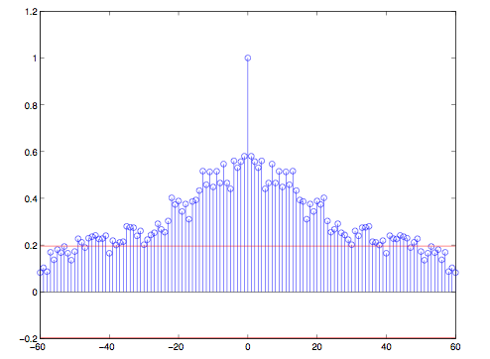
Sample ACF: Trend

Slide 48
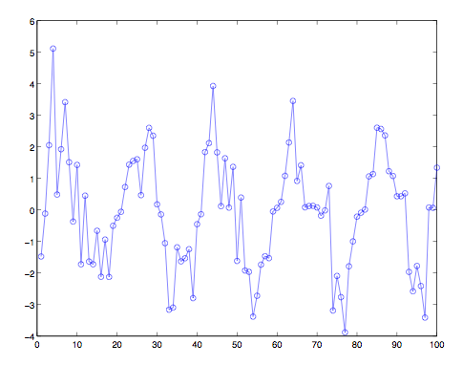
Periodic

Slide 49
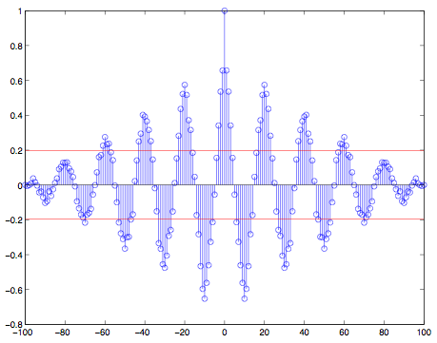
Sample ACF: Periodic

Slide 50
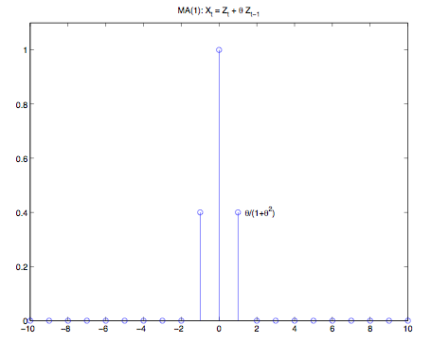
ACF: MA(1)

Slide 51

ACF: AR

Slide 52

ARMA

Slide 53
Simulation examples
# some AR(1)
x1 = arima.sim(list(order=c(1,0,0), ar=.9), n=100)
x2 = arima.sim(list(order=c(1,0,0), ar=-.9), n=100)
par(mfrow=c(2,1))
plot(x1, main=(expression(AR(1)~~~phi==+.9))) # ~ is a space and == is equal
plot(x2, main=(expression(AR(1)~~~phi==-.9)))
par(mfcol=c(2,2))
acf(x1, 20)
acf(x2, 20)
pacf(x1, 20)
pacf(x2, 20)
# an MA1
x = arima.sim(list(order=c(0,0,1), ma=.8), n=100)
par(mfcol=c(3,1))
plot(x, main=(expression(MA(1)~~~theta==.8)))
acf(x,20)
pacf(x,20)
# an AR2
x = arima.sim(list(order=c(2,0,0), ar=c(1,-.9)), n=100)
par(mfcol=c(3,1))
plot(x, main=(expression(AR(2)~~~phi[1]==1~~~phi[2]==-.9)))
acf(x, 20)
pacf(x, 20)

Slide 54
Simulation example
x = arima.sim(list(order=c(1,0,1), ar=.9, ma=-.5), n=100) # simulate some data
(x.fit = arima(x, order = c(1, 0, 1))) # fit the model and print the results
tsdiag(x.fit, gof.lag=20)# diagnostics
x.fore = predict(x.fit, n.ahead=10)
# plot the forecasts
U = x.fore$pred + 2*x.fore$se
L = x.fore$pred - 2*x.fore$se
minx=min(x,L)
maxx=max(x,U)
ts.plot(x,x.fore$pred,col=1:2, ylim=c(minx,maxx))
lines(U, col="blue", lty="dashed")
lines(L, col="blue", lty="dashed")

Slide 55

Examples
library(tseries)
air <- AirPassengers
ts.plot(air)
acf(air)
pacf(air)

Slide 56
Examples
For classical decomposition:
plot(decompose(air))
Fitting an ARIMA model:
air.fit<-arima(air,order=c(0,1,1),seasonal=list(order=c(0,1,1),period=12)) tsdiag(air.fit)
Forecasting:
library(forecast) air.forecast <- forecast(air.fit) plot.forecast(air.forecast)

